Slide 1

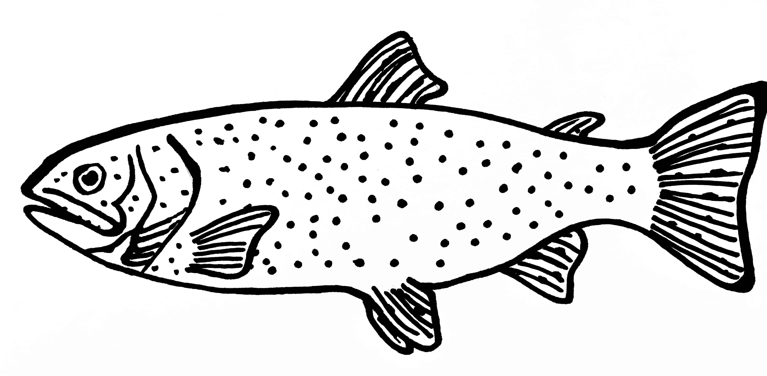
INPUTS
MODELS
OUTPUT
FINGERPRINTS
DESCRIPTORS
= TABULAR
RANDOM
FOREST
&
MLP
LC50
Toxicity
……………………
0.7 | 0.1 | …
1 | 0 | 1 | … | 1 | 0
PREDICT
GENERAL
CHEMICAL REPRESENATION
SPECIES-SPECIFIC
Bi-GRU
&
TRANS-
FORMER
NC P(O)(O) =O
= SEQUENTIAL
SMILES
EXPLAIN
Latent Space:
SMILES EMBEDDING
0.1 | 0.5 | 0.7 | …
SPECIES TRAITS

Slide 2
INPUTS
MODELS
OUTPUT
FINGERPRINTS
DESCRIPTORS
LC50
……………………
0.7 | 0.1 | 0.4 | …
RANDOM FOREST
1 | 0 | 1 | … | 1 | 0
TABULAR
PREDCIT
GENERAL TOXICITY
CHEMICAL
REPRESENTATIONS
DNN
SPECIES-SPECIFIC
TOXICITY
SEQUENTIAL
NC P(O)(O) =O
SMILES
EMBEDDING
SMILES
Latent Space
Bi-GRU
EXPLAIN
SPECIE STRAITS
0.1 | 0.5 | 0.7 | …
TRANSFORMER

